Slide 1
How We Can Represent a Problem with Python
By: Iman Khani Jazani
Senior Data Scientist, Adin
Technical AI Product Manager and Advisor, Mehra
AI and Data Specialist, AiHum
Adjunct Professor, Sharif University of Technology

Slide 2
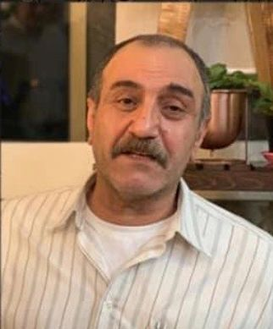
به یاد استاد عباس نوذری عزیز...

Slide 3
Last Lecture
Short Presentations
Review the Last Lecture
Primitive Instructions
Language Structure
Python Programming Language
Application of Programming in the Digital Age!

Slide 4
Today
Short Presentation
Review the Last Lecture
Problem Modeling
Data types in Python
Interpret your commands with Python
Programming with Python
Application of Programming in the Digital Age!

Slide 5
Together
Send your feedback about the class whenever you want!

Slide 6
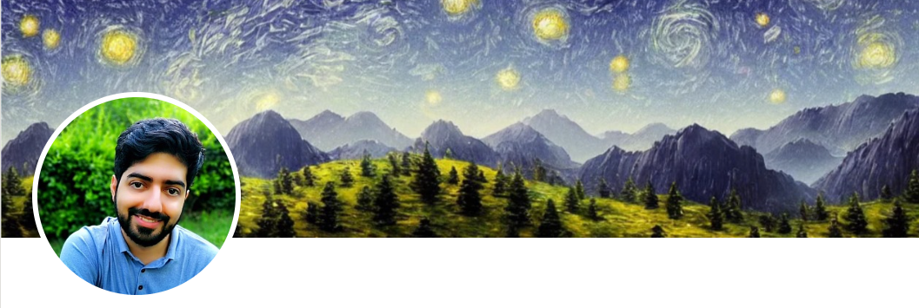
Contact me
Gmail: ImanKhaniJazani@gmail.com
LinkedIn: https://www.linkedin.com/in/ImanKhaniJazani/
Telegram: @IKJ1992

Slide 7

Main links for our class
گروه خصوصی شد!
Telegram group: *
GitHub organization: github.com/SharifPythonSpace

Slide 8
Grading
راه جبران هم تحت شرایطی وجود داره!
Approx. 25% Programming Assignments (judgment with Quera)
Approx. 14% Mid-term Project (alone, judgment with TAs and Quera)
Approx. 37% Final Project (team work~5 member, judgment with TAs and Quera)
Proposal (about real needs)
Coding
Release
Approx. 30% Final Exam (algorithm-based paper exam)
Approx. 5% Short Presentation(extra score , for the next week lecture, only for the first two person)
Approx. 2% Challenging Questions and Contributions in Class (extra score)
Approx. 7% long presentation (extra score)
Notes:
120 score

Slide 9
Short Presentations

Slide 10
We have six core (primitive) instructions. What are these and WHY are these?
Who is volunteer for the short presentation?
Short Presenration

Slide 11
Review the Last Lecture

Slide 12
Main vocabs
Computation
Computer
Algorithm
Program
Programming language
…

Slide 13
Building block of languages
Today programming languages have more convenient set of primitives.
We can create new primitives…
Anything computable in one language is computable/ transformable in/to another languages.

Slide 14
Level of processing in a language!
Word-level (primitives)
Syntax
Semantic
Discourse (valid result)

Slide 15
Every things have a language!?
Genes
Humans
Computer
Mechanical device
Trees
Animals
Algorithms
Programming (formal)
…

Slide 16
Problem Modeling

Slide 17
How to convert a problem to a machine language?
Needs analysis
…
Well-defined problem definition
Write an algorithm in a paper or your brain!
Select a suitable programming language
Write a program
Run compiler or interpreter

Slide 18
From question to algorithm!
Understand your needs or questions!
explain easily for someone else
Decompose your problem (make some steps)!
Make a flowchart for the decomposed version of your problem
Explain each steps in one or two sentences (paper-based or paperless)
input, output, process
Explain each steps mathematically…
Develop your algorithms for each steps
Check your process flow from the first step to the last one!

Slide 19
Different problem, different data!
You can encounter with different types of data in input, output, or even in process (auxiliary)
Tabular
Numerical
Audio
Text
Image
Video
List of items
…

Slide 20
Data Types in Python

Slide 21
Welcome to Python!🎉

Slide 22
Python Features
Easy to read
Easy to learn
Interactive mode
Portable
Fast to develop
Many different libraries
Excellent community and support
Open-source
Scalable
…

Slide 23
How we can encode your data with computer language!?
We should convert your data to binary format!
Different data, different strategy to convert the data!
number: number to binary, binary to number,…
string: unicode, …
…

Slide 24
Data in Python
Primitive data
Numbers
Int, float, complex
String
List
Tuple
Set
dictionary
User-defined data
Class
single
sequence

Slide 25
Continue your learning with Parsa!
Parsa’s Workshop is about Data Representation!

Slide 26
Interpret your commands with Python

Slide 27
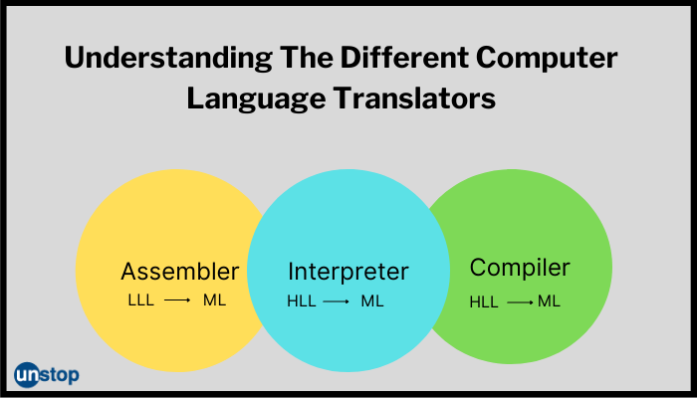
Compiler vs. interpreter

Slide 28
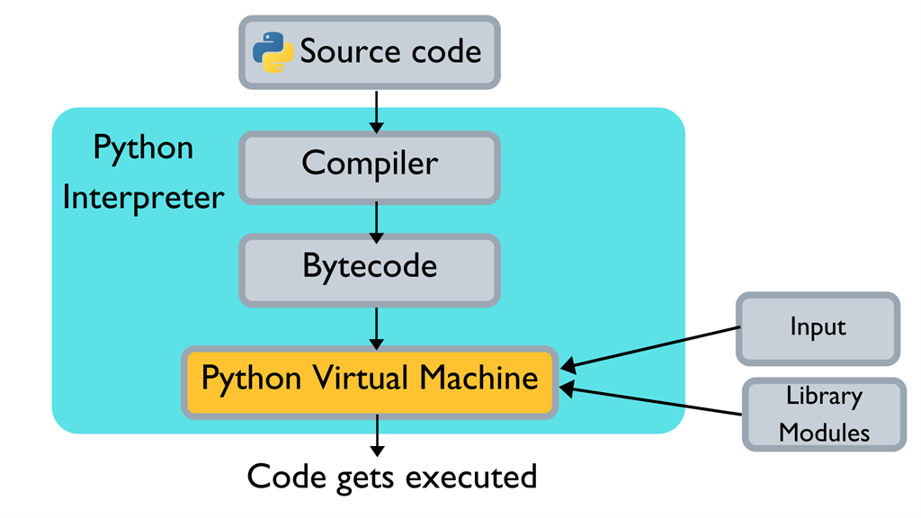
How Python Works

Slide 29
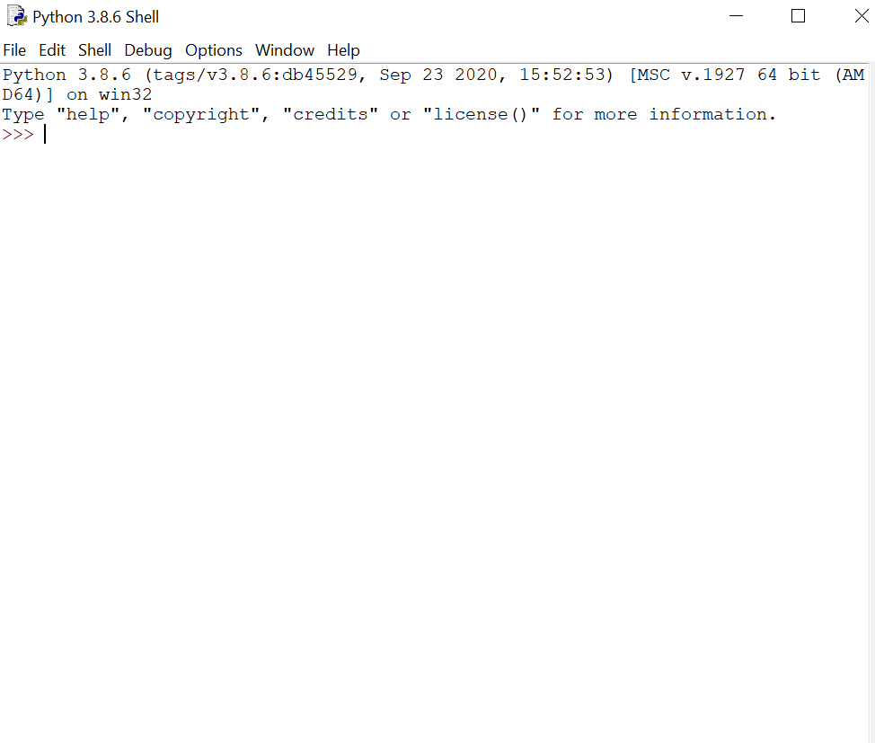
IDLE: simple IDE for Python
Execute line by line,
Let’s do it!

Slide 30
Programming with Python

Slide 31
Question
What is the website need?
How can we get more users for our news website?

Slide 32
From question to algorithm!
Understand your needs or questions!
explain easily for someone else
Decompose your problem (make some steps)!
Make a flowchart for the decomposed version of your problem
Explain each steps in one or two sentences (paper-based or paperless)
input, output, process
Explain each steps mathematically…
Develop your algorithms for each steps
Check your process flow from the first step to the last one!

Slide 33

Find dictionary of a text
Input: text
Output: some statistics (count)

Slide 34
خبر خوووووب!

Slide 35
Application of Programming in the Digital Age!

Slide 36

Trip…

Slide 37
Design and explain a flowchart for a simple Homsa! You can propose new features!
Who is volunteer for the short presentation?
Short Presenration

Slide 38
Lecture Resources

